Slide 1




TEAM_D
ALL-IN LESSON
Bi-weekly progress meeting #3
Team D
이승환, 이채연, 박문희, 정재윤
2024.11.22

Slide 2


ALL-IN LESSON
CONTENTS
1
Objective & Goals
2
Weekly Progress
3
Role Distribution
4
Demo Videos & Features
5
Challenges & Limitations
6
Scheduled Plans

Slide 3



ALL-IN LESSON
01.
Objective
& Goals
(RECAP)
Why?
- use multiple tools for single purpose of tutoring
- no integrated management tool for students or parents
What?
- all-in-one web application designed for each roles
(tutors, students, parents)
How?
Tutor - Integrated calendar, multiple students' report,
managing diverse curricula for each
Student - Integrated calendar, personal achievements,
assignments/supplements, reward system,
progress report
Parent - Quick-look calendar, tuition payment dates,
student's report

Slide 4
ALL-IN LESSON
02. Weekly Progress
 | Week 9 | Week 10 | Week 11 | Week 12 | Week 13 | Week 14
Backend | DB Schema
 | Login API
Frontend | Figma
 | Implementation
Integration |  |  | FE/BE Integration
Beta Version |  |  |  |  |  | Beta Testing
 |  |  |  |  | Debugging

Slide 5


ALL-IN LESSON
[ Front-end ]
03.
Role
Distribution
Tutor Manager
Mini Calendar
Parent Home
Tutor Calendar
Student Home
Student Calendar
박문희
정재윤
이승환
이채연
Daily records / Assignment APIs
Update settings API & DB Link
FE matching up with Figma (help)
Custom Login FE &API & DB Link
Tutor FE & API & DB Link
[ Back-end ]

Slide 6

ALL-IN LESSON
[ Front-end ]
03.
Role
Distribution
< TODO >
Finish up student manager
Edit parents’ calendar
Page organization
Improve Tutor/Student Home style
Parents Calendar
박문희
정재윤
LaTeX
이승환
이채연
Finish up APIs
BE Supplementary Tasks
Integrate LaTeX
Student FE & API & DB Link
Parent API & DB Link
Deploy Beta Testing (tutor)
[ Back-end ]

Slide 7
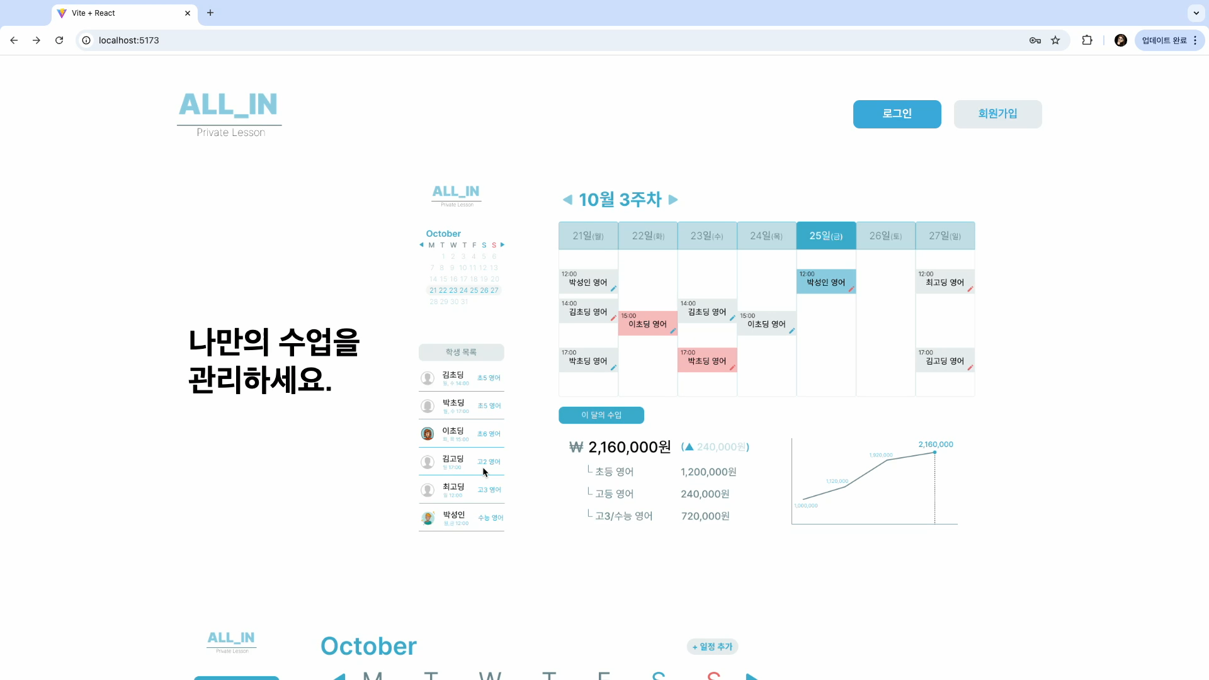
ALL-IN LESSON
04. Demo Videos & Features

Slide 8
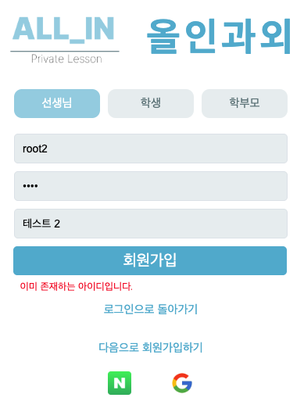
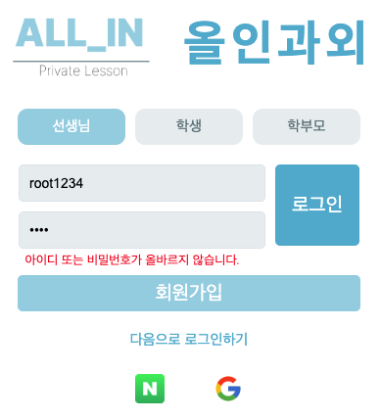
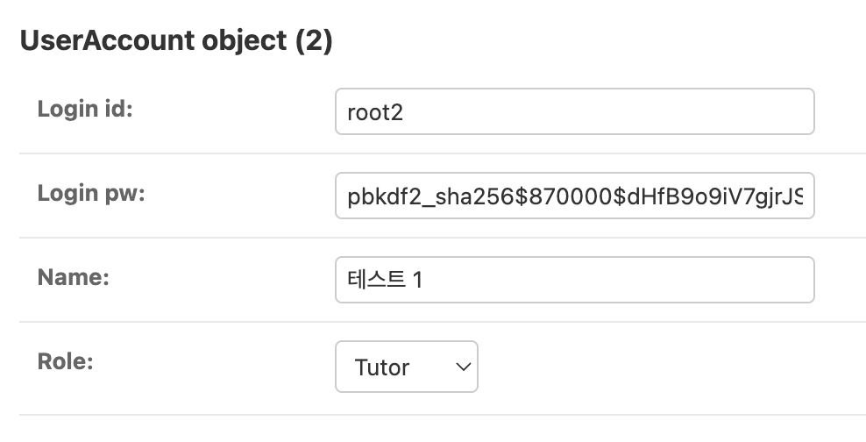
ALL-IN LESSON
04. Demo Videos & Features
[ Authentication ]
Hash passwords & insert data
django.contrib.auth.hashers module
(make_password / check_password)
[ Sign Up ]
Check Existence (no duplicate ID)
ID / PW / name required
[ Login ]
Match ID / PW with database
* Choose roles

Slide 9
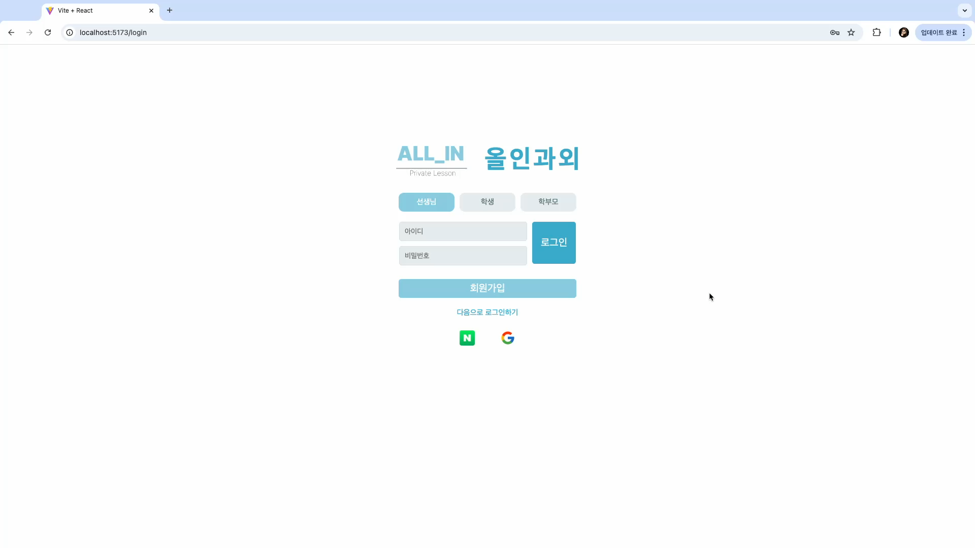
ALL-IN LESSON
04. Demo Videos & Features

Slide 10
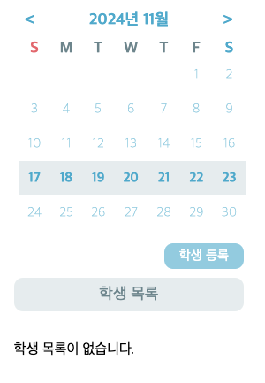
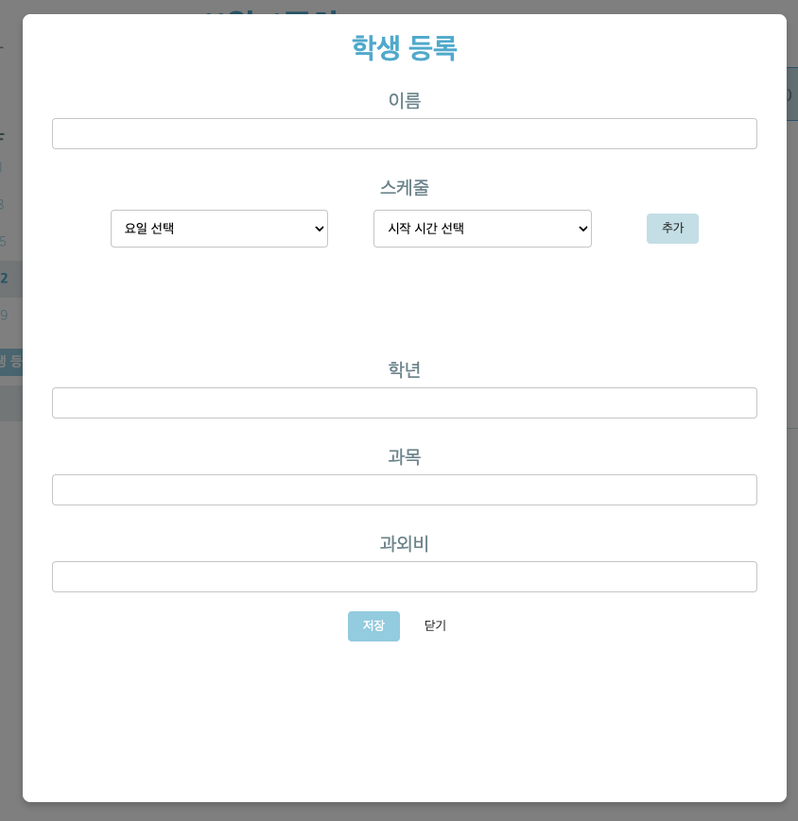
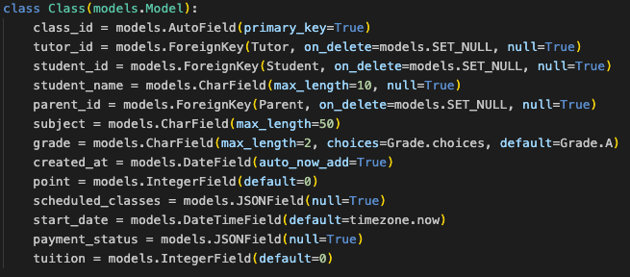
ALL-IN LESSON
04. Demo Videos & Features
[ Student Register ]
Name, Schedule, Grade, Subject, Tuition Required
✓
[ Empty Student List ]
Default state for first logging in
✓

Slide 11
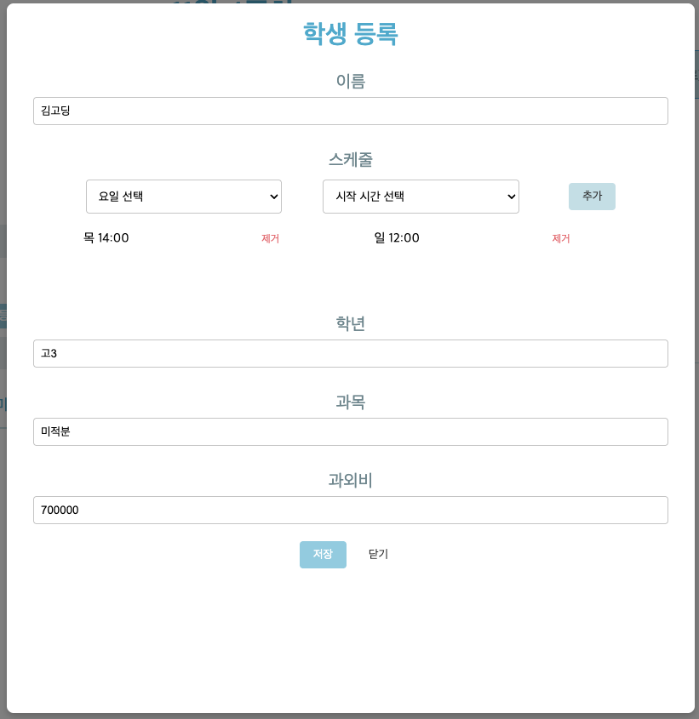
ALL-IN LESSON
04. Demo Videos & Features
[ Empty Student List ]
Default state for first logging in

Slide 12
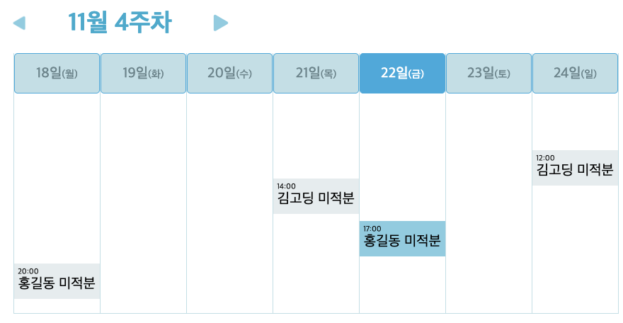
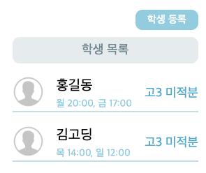
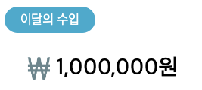
ALL-IN LESSON
04. Demo Videos & Features
[ Student List ]
Name, Schedule, Grade, Subject
No limit for student registration
Navigate to Student Report
[ Weekly Schedule Bar ]
Today’s schedule highlighted
Can record daily lesson information
Background color -> Canceled? Makeup?
[ Tuition ]
Total tuition for this month

Slide 13
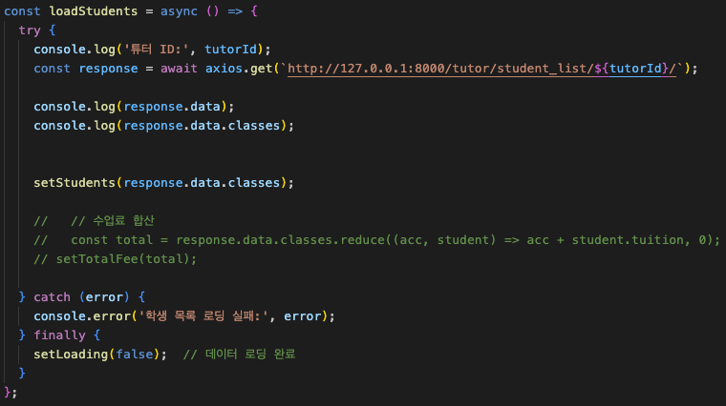
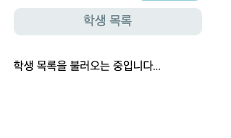
ALL-IN LESSON
04. Demo Videos & Features
???
FINE
Erroneous when used immediately

Slide 14
ALL-IN LESSON
04. Demo Videos & Features

Slide 15
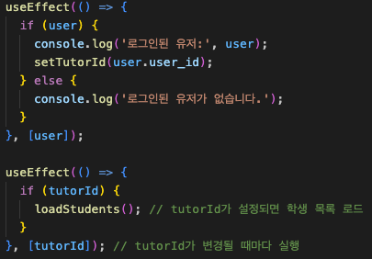
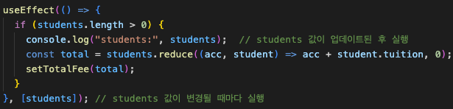
ALL-IN LESSON
04. Demo Videos & Features

Slide 16
ALL-IN LESSON
04. Demo Videos & Features

Slide 17
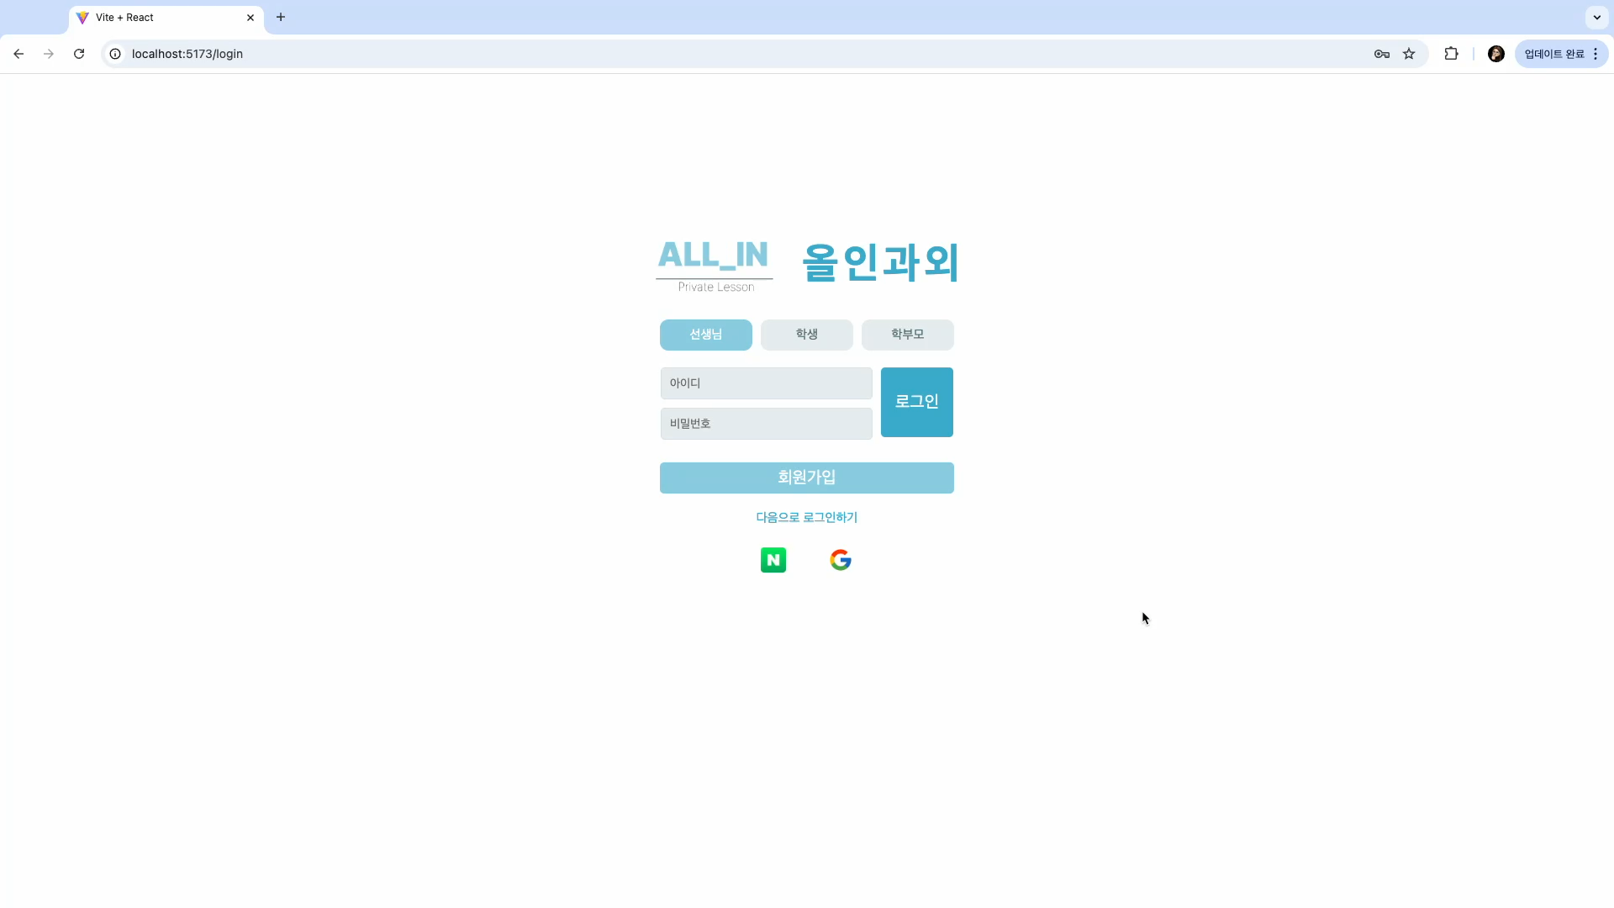
ALL-IN LESSON
04. Demo Videos & Features

Slide 18
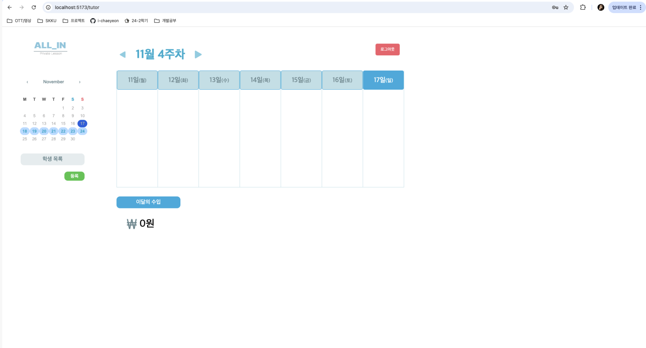
ALL-IN LESSON
05. Challenges & Limitations
X use the whole page size
Calendar, Student list layout differs Figma

Slide 19
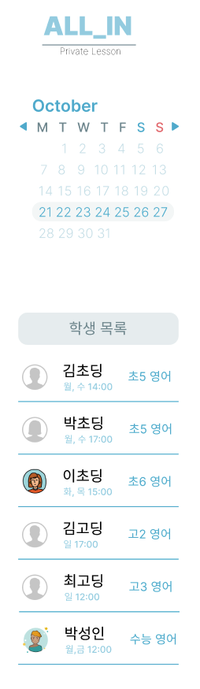
ALL-IN LESSON
05. Challenges & Limitations
X use the whole page size
Calendar, Student list layout differs Figma

Slide 20
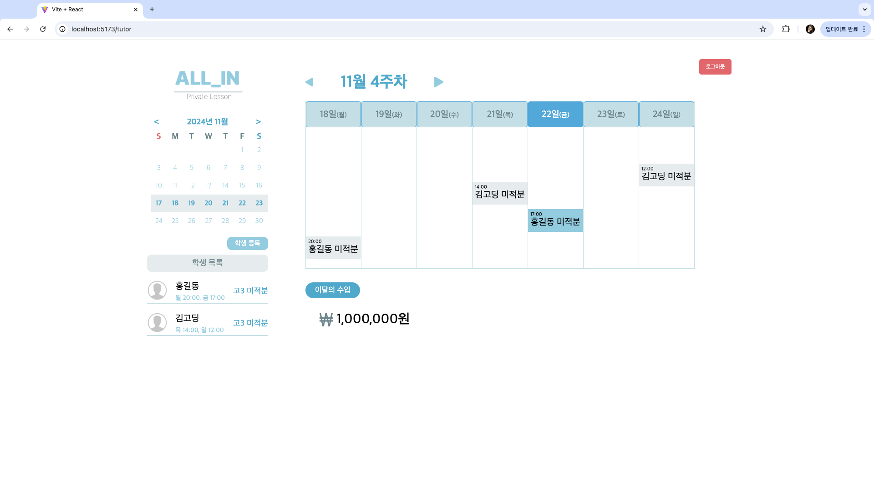
ALL-IN LESSON
05. Challenges & Limitations
X use the whole page size
Calendar, Student list layout differs Figma
Solved ✓
Solved ✓

Slide 21
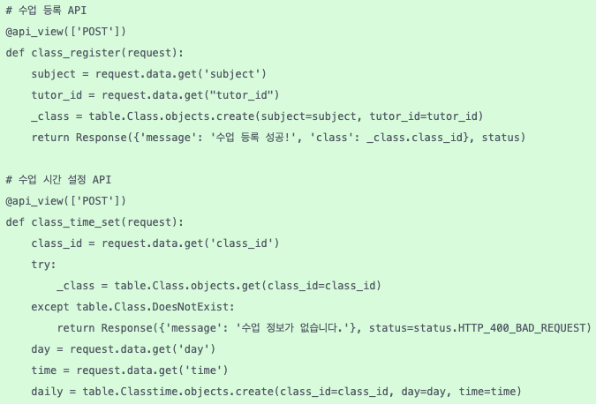
ALL-IN LESSON
05. Challenges & Limitations

Slide 22
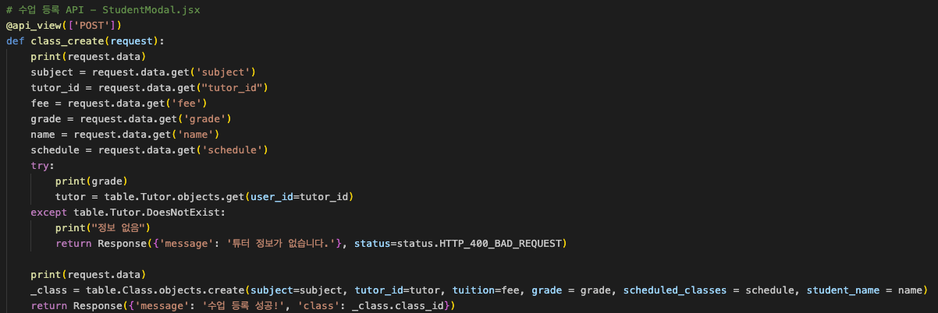
ALL-IN LESSON
05. Challenges & Limitations

Slide 23



ALL-IN LESSON
05. Challenges & Limitations
Not appropriate to test
Limitations in concurrent access
Security issues (no authentication features)

Slide 24

ALL-IN LESSON
06. Scheduled Plans
 | Week 13 | Week 14
Frontend | Finish up Student / Parent pages
Backend | Link APIs with FE
Beta Version | Beta Testing
 | Debugging

Slide 25
ALL-IN LESSON
THANK YOU.
Team_D

